Slide 1
UK Child Student & Student Route

Slide 2
Agenda
Who needs a Child Student Visa
Who do not need a Child Student Visa
The application process
Costs
How we can help

Slide 3
Who needs a Child Student Visa

Slide 4
You will need to apply for a Child Student Visa if:
Age between 4 – 17
Have an unconditional offer (met the schools entry requirements)
UK Independent, fee-paying school with an accredited Sponsor Licence
Intend to study a course of at least 6 months

Slide 5
Who do not need a Child Student Visa

Slide 6
You do not need to apply for a Child Student Visa if:
Age 18+ (Student Visa)
Course is less than 6 months (One or Two Terms) - Visitor status
Signed Parental Consent Letter by both biological parents
Evidence of sole custody
Copy of return flight details
E-gates
Invitation letter from school
BUT, if the term is longer than 180 in total = Visa

Slide 7
What is the application process

Slide 8
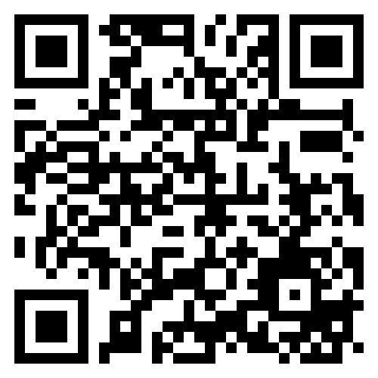

Slide 9
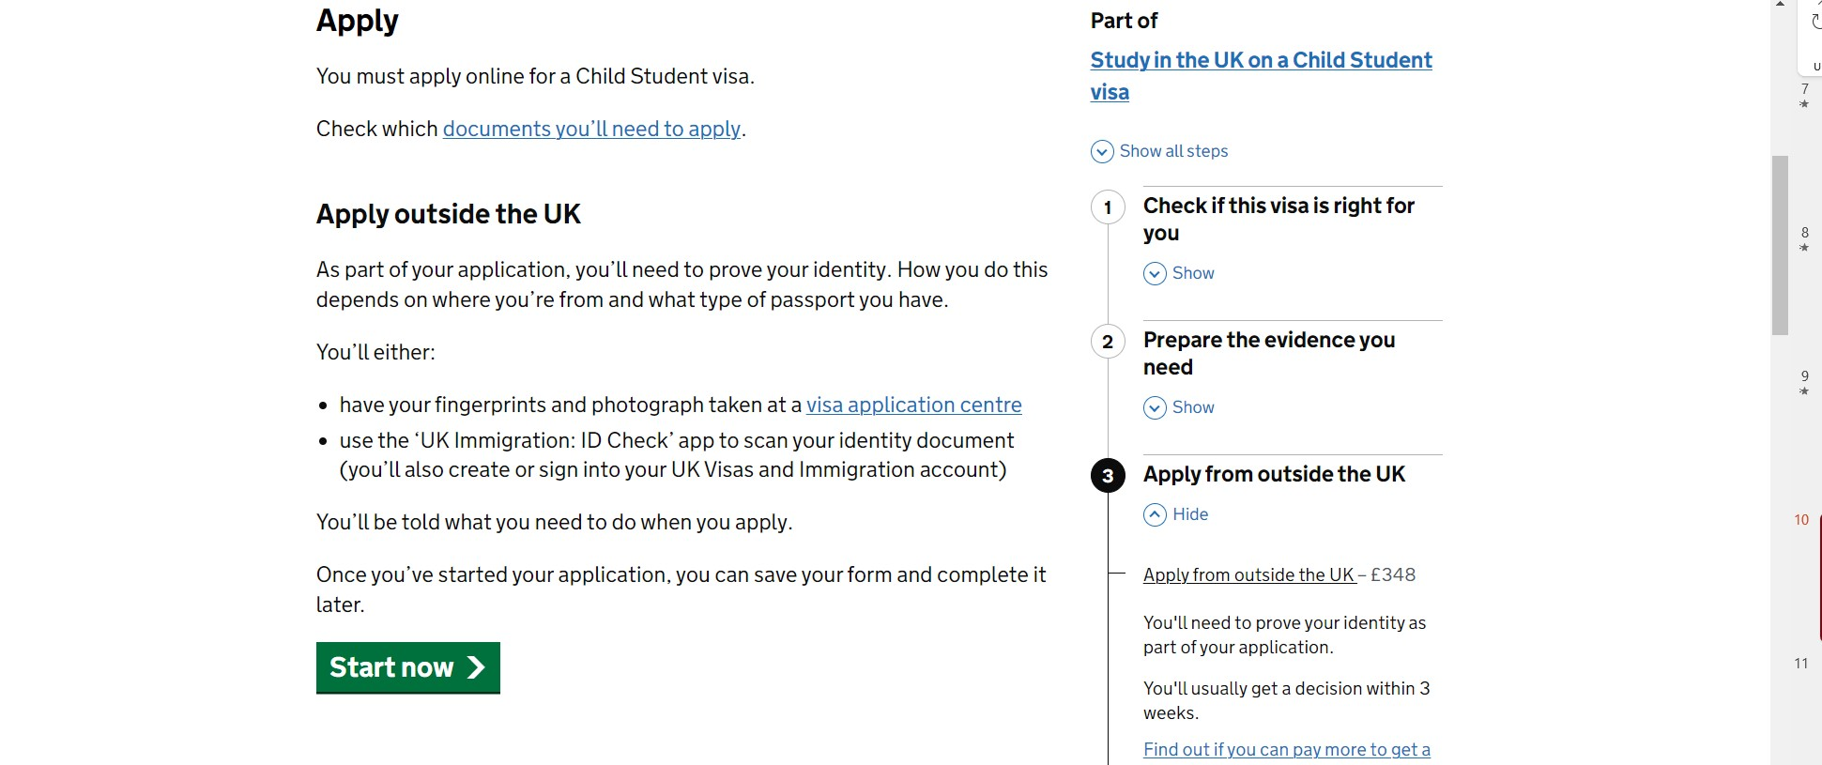

Slide 10
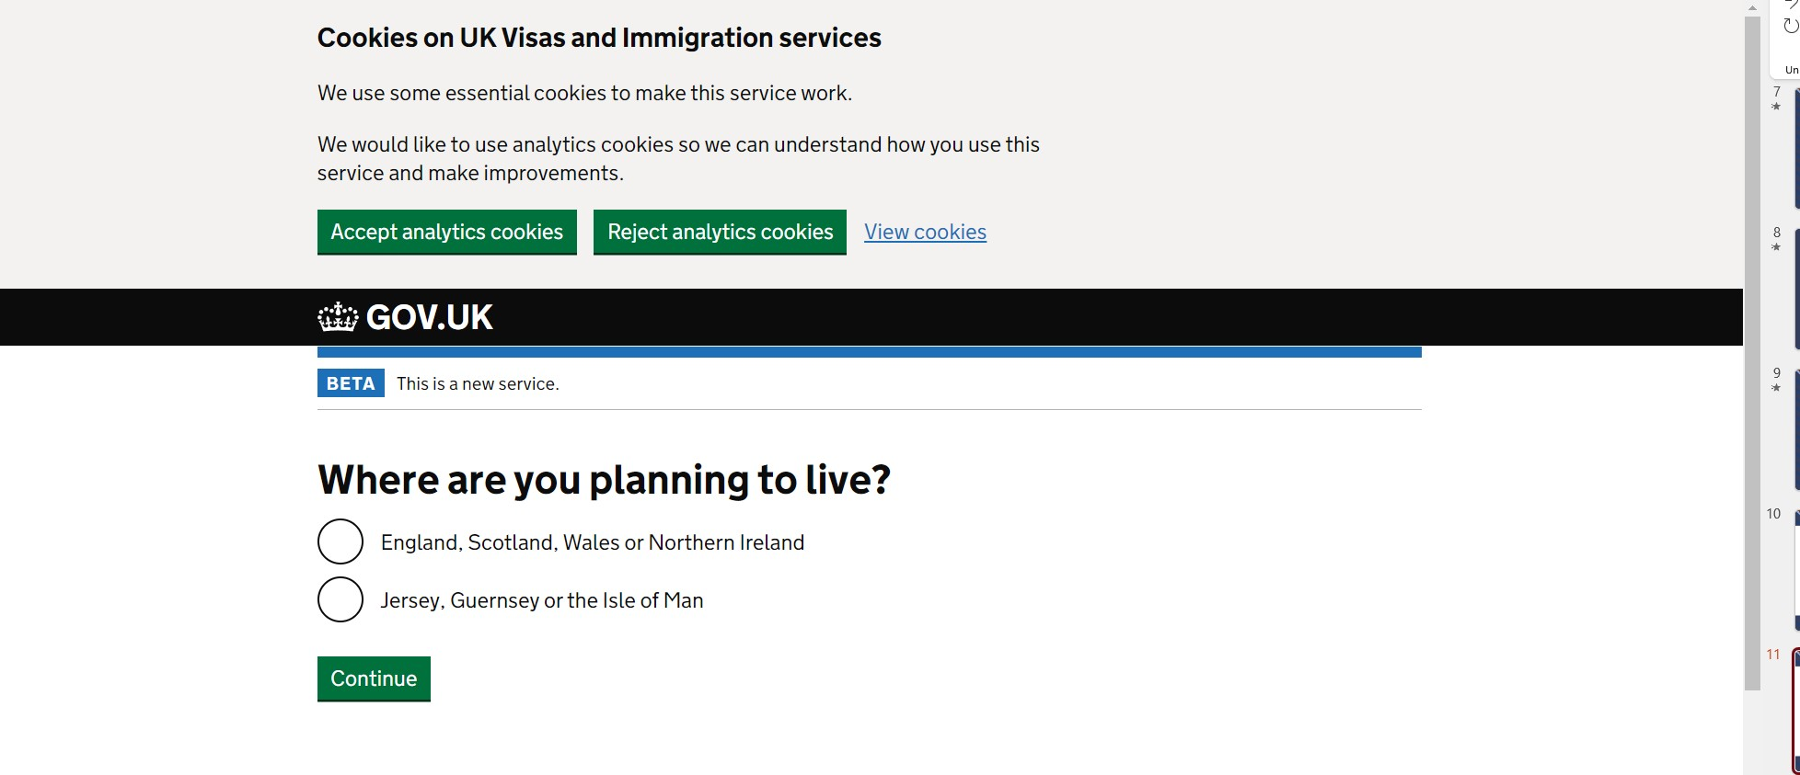

Slide 12
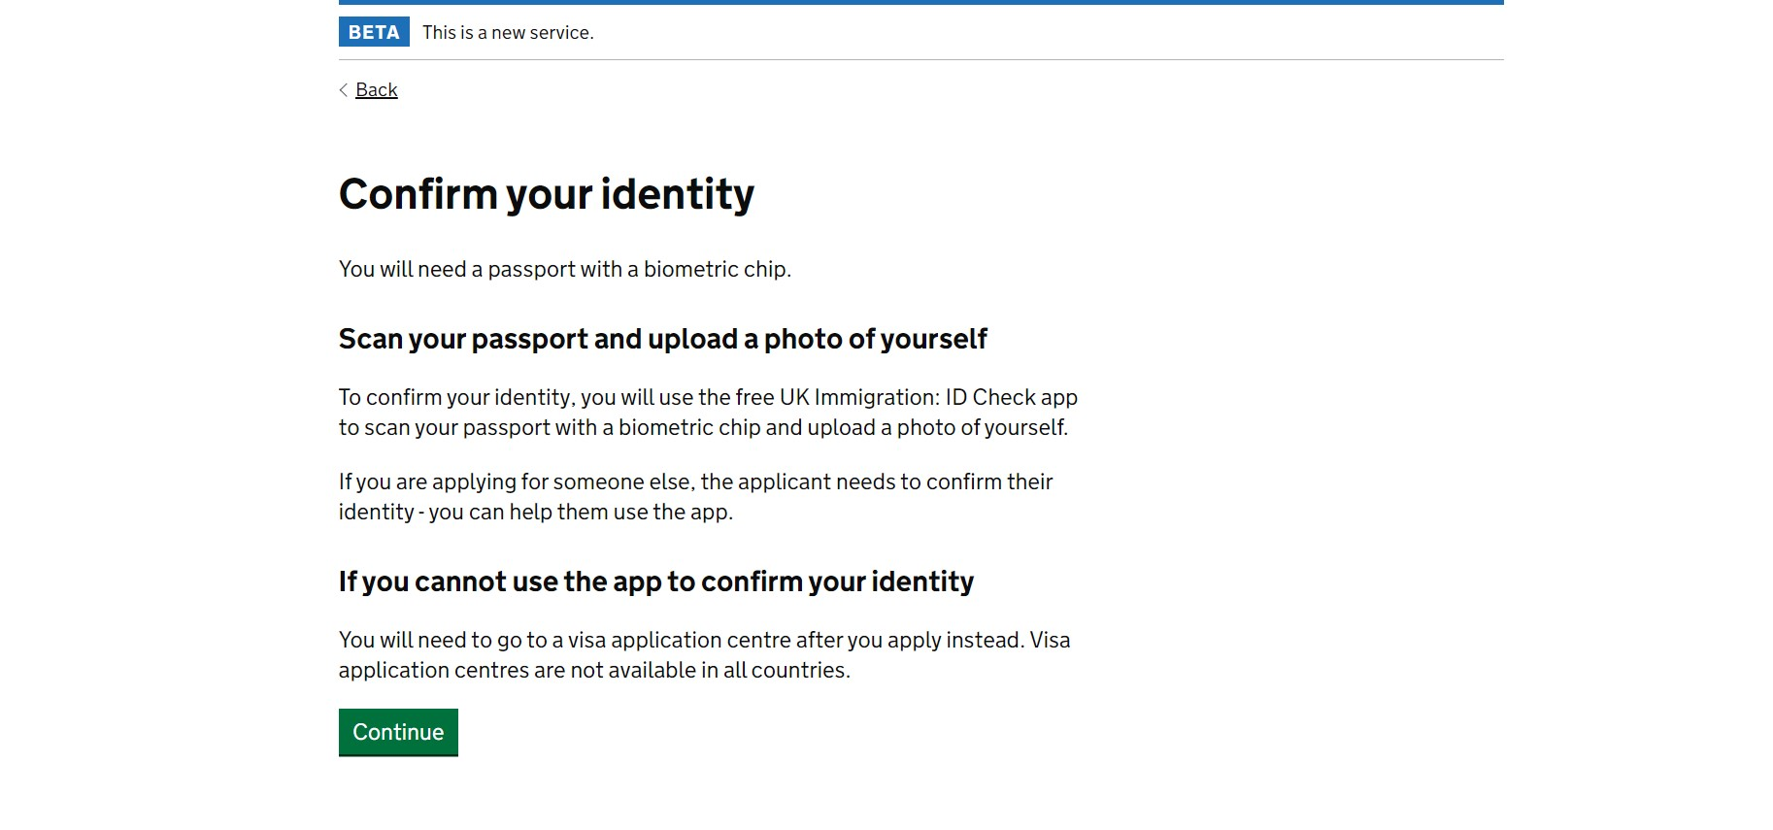

Slide 13
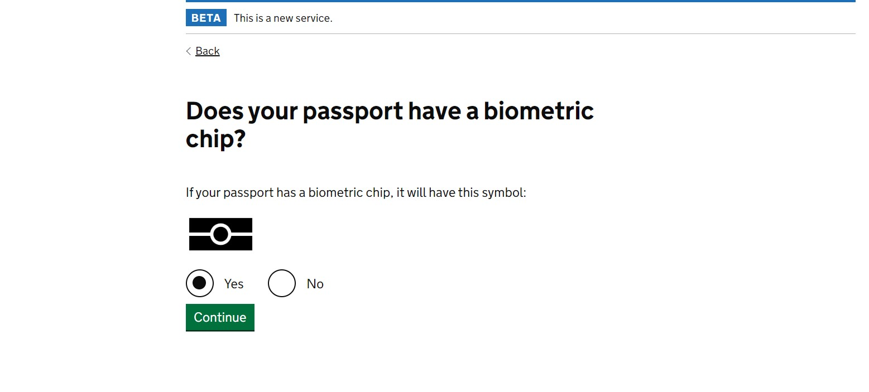

Slide 14
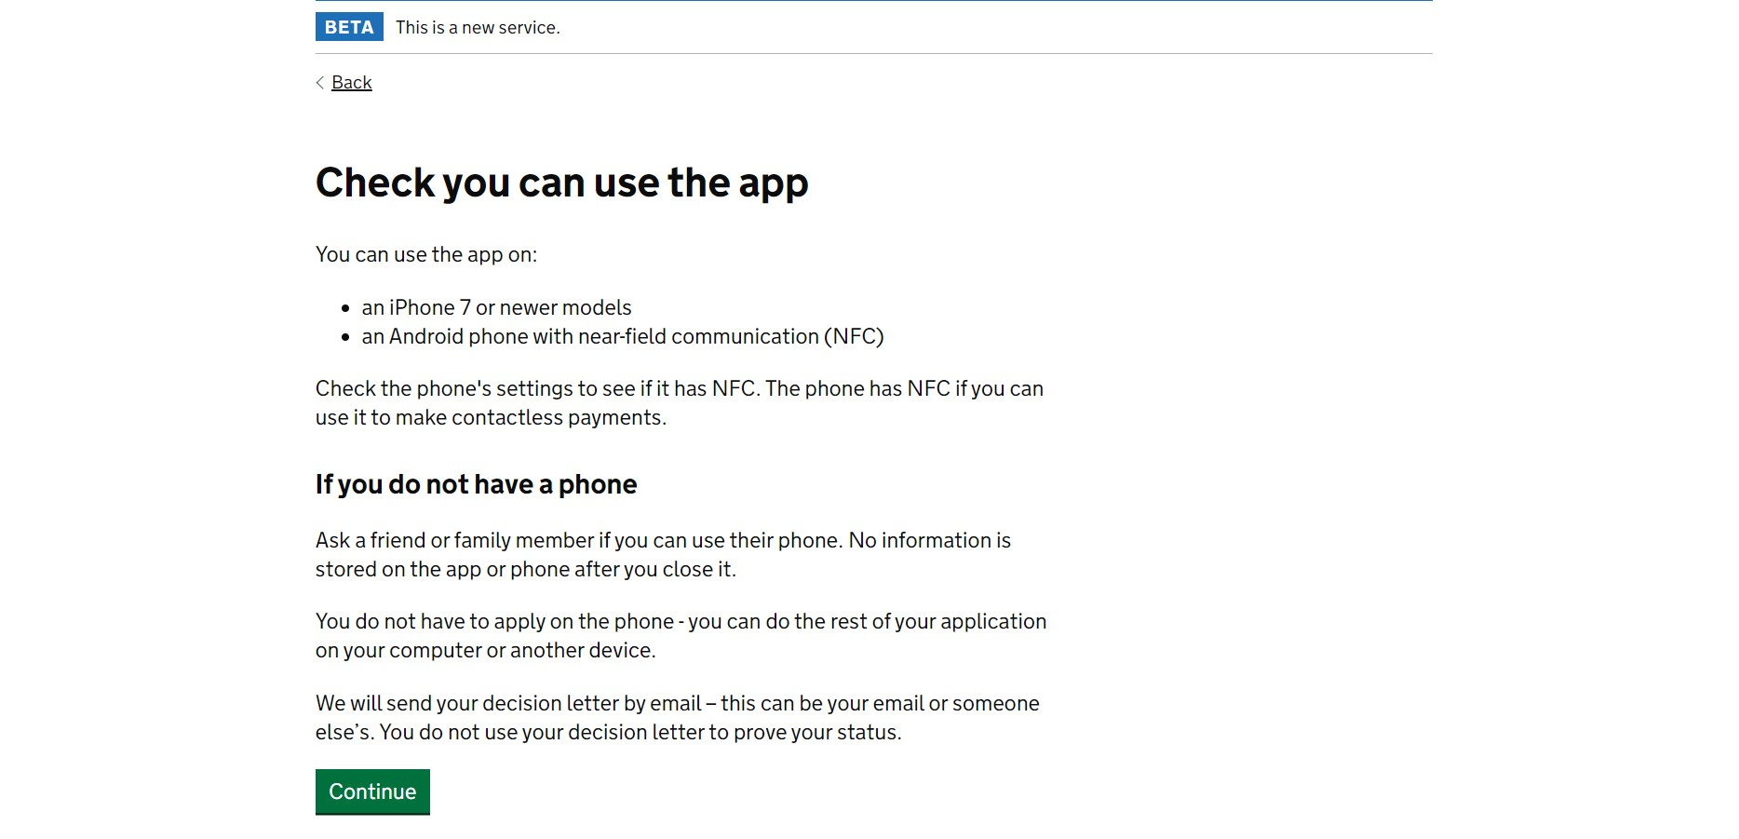

Slide 15
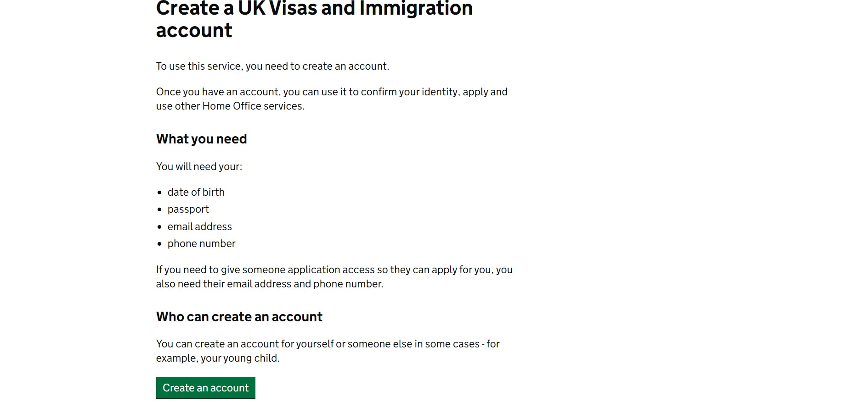

Slide 16
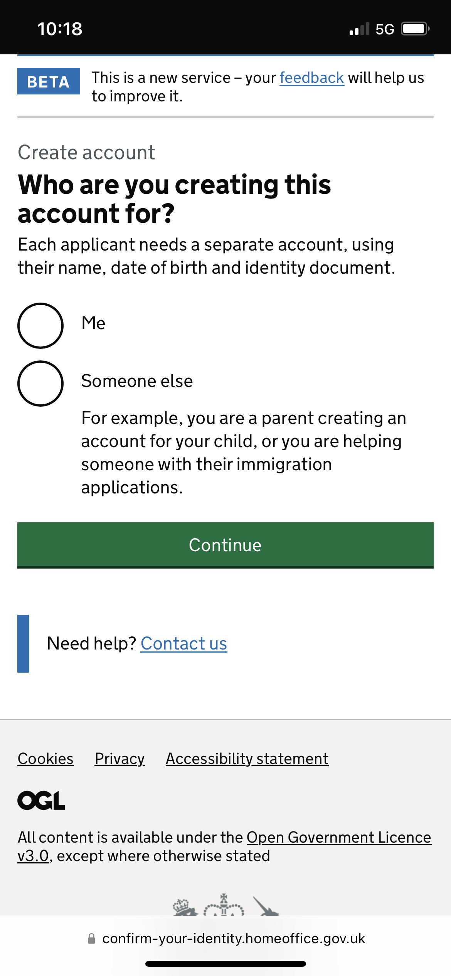

Slide 17
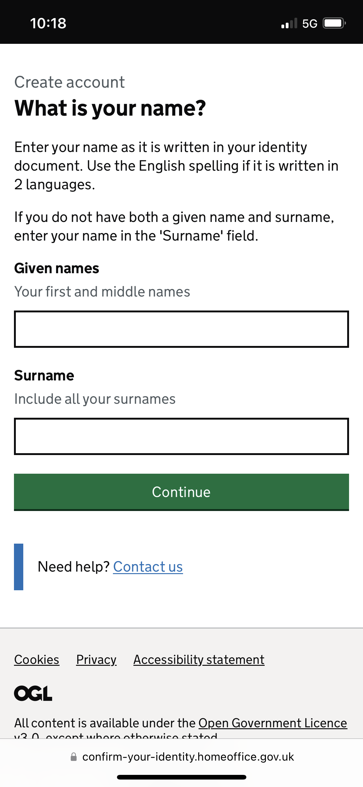

Slide 18
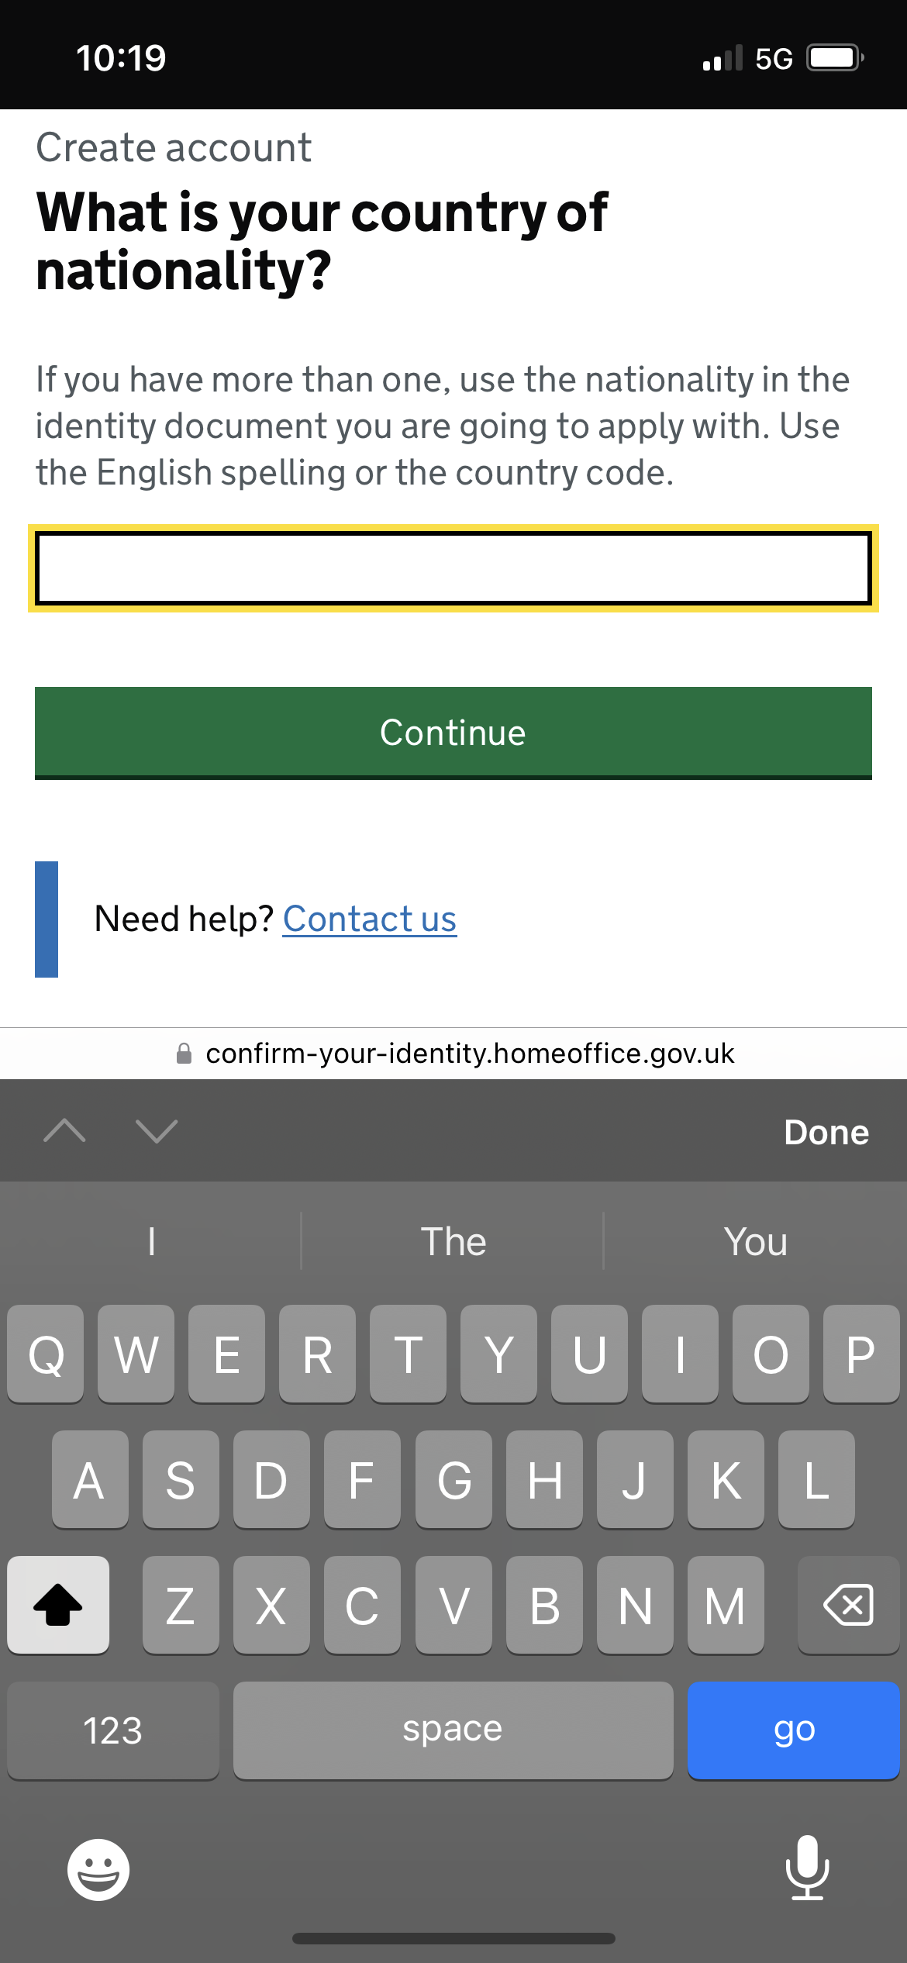

Slide 19
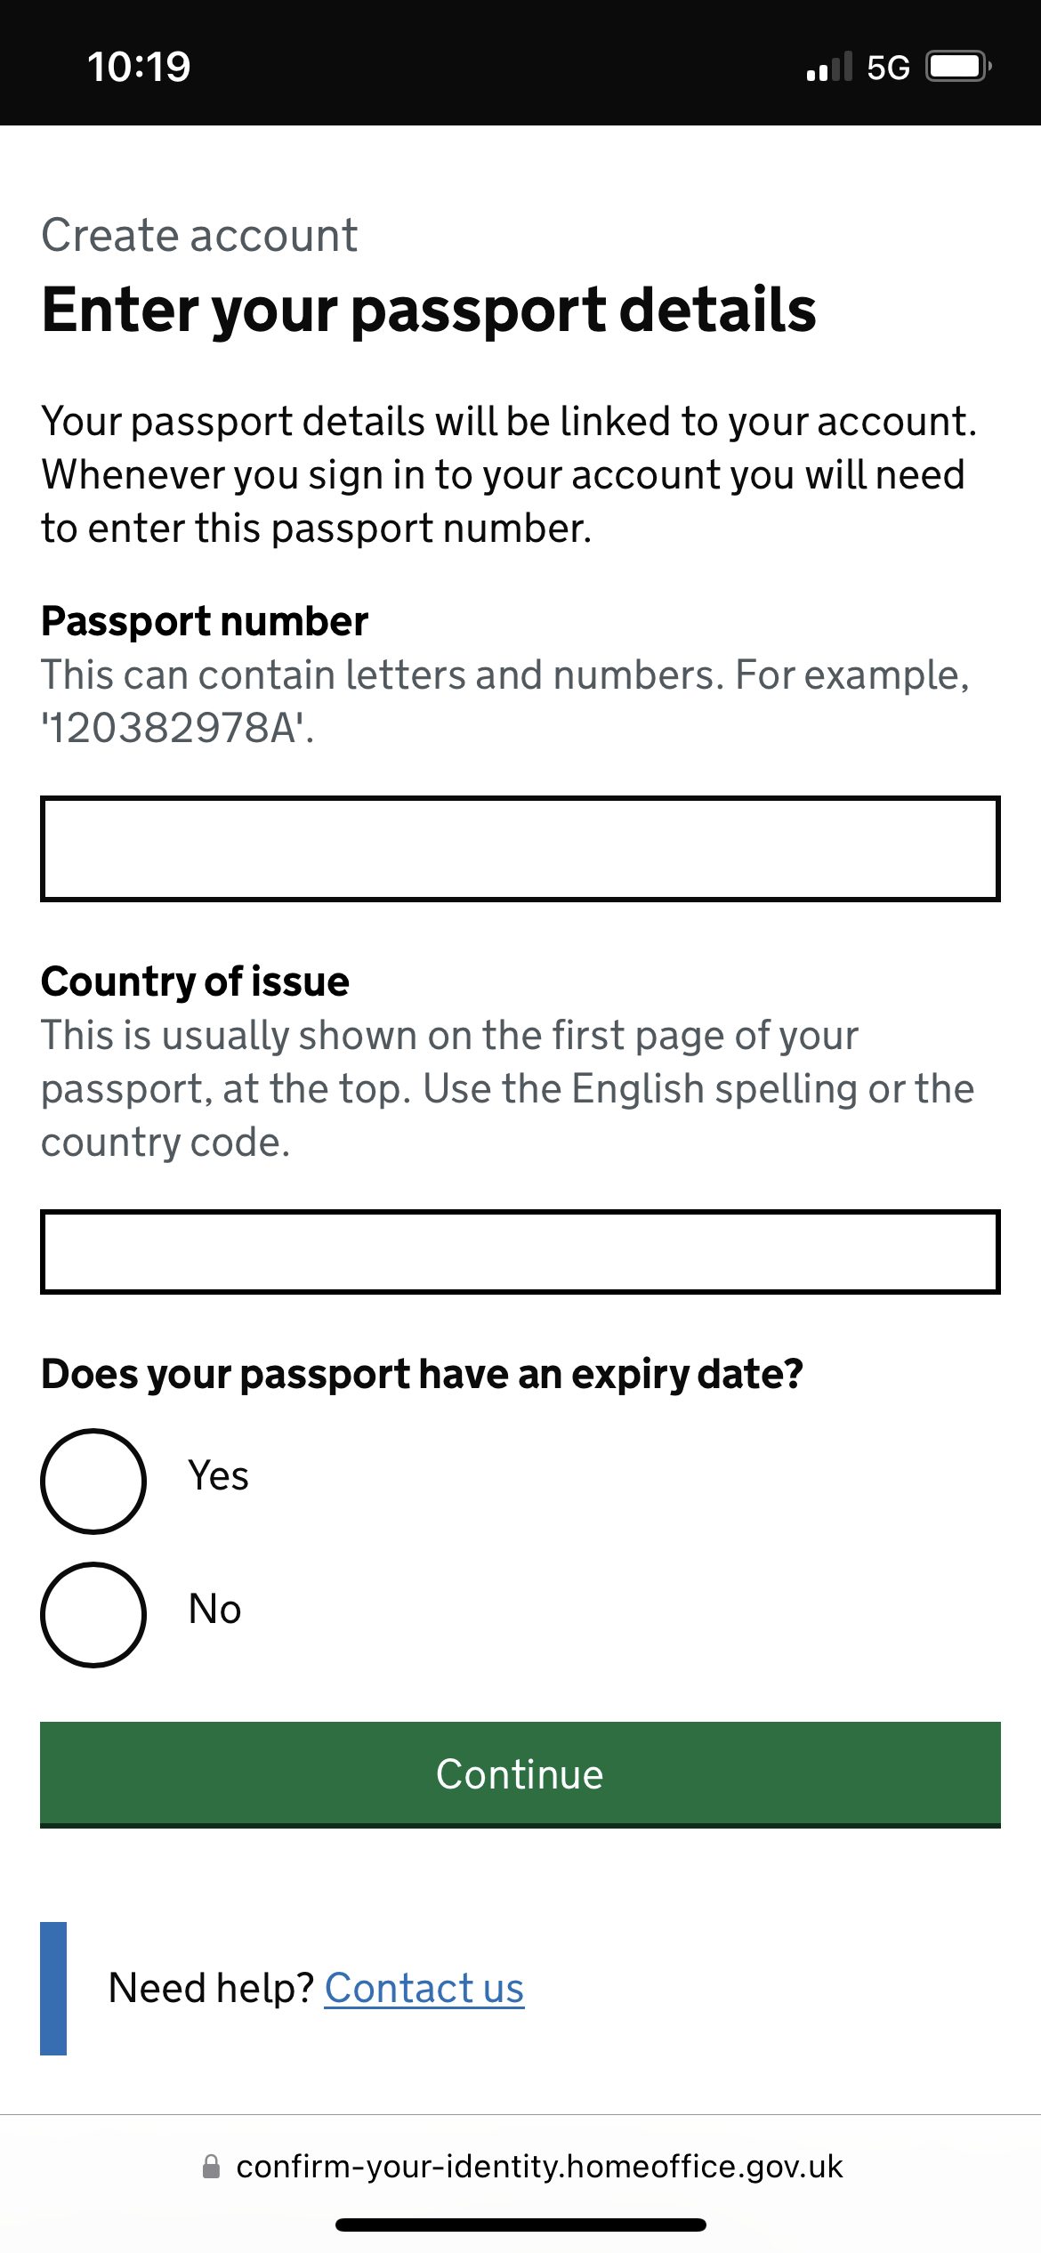

Slide 20
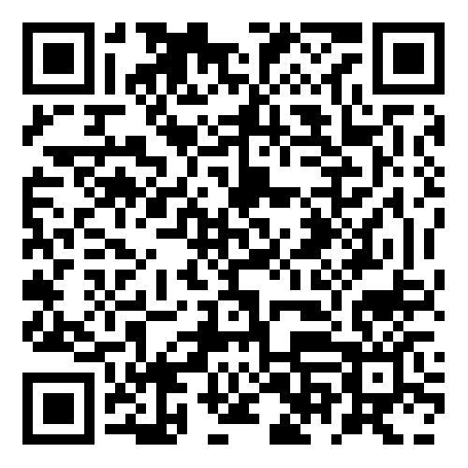
iPhone QR

Slide 21
Android QR

Slide 22
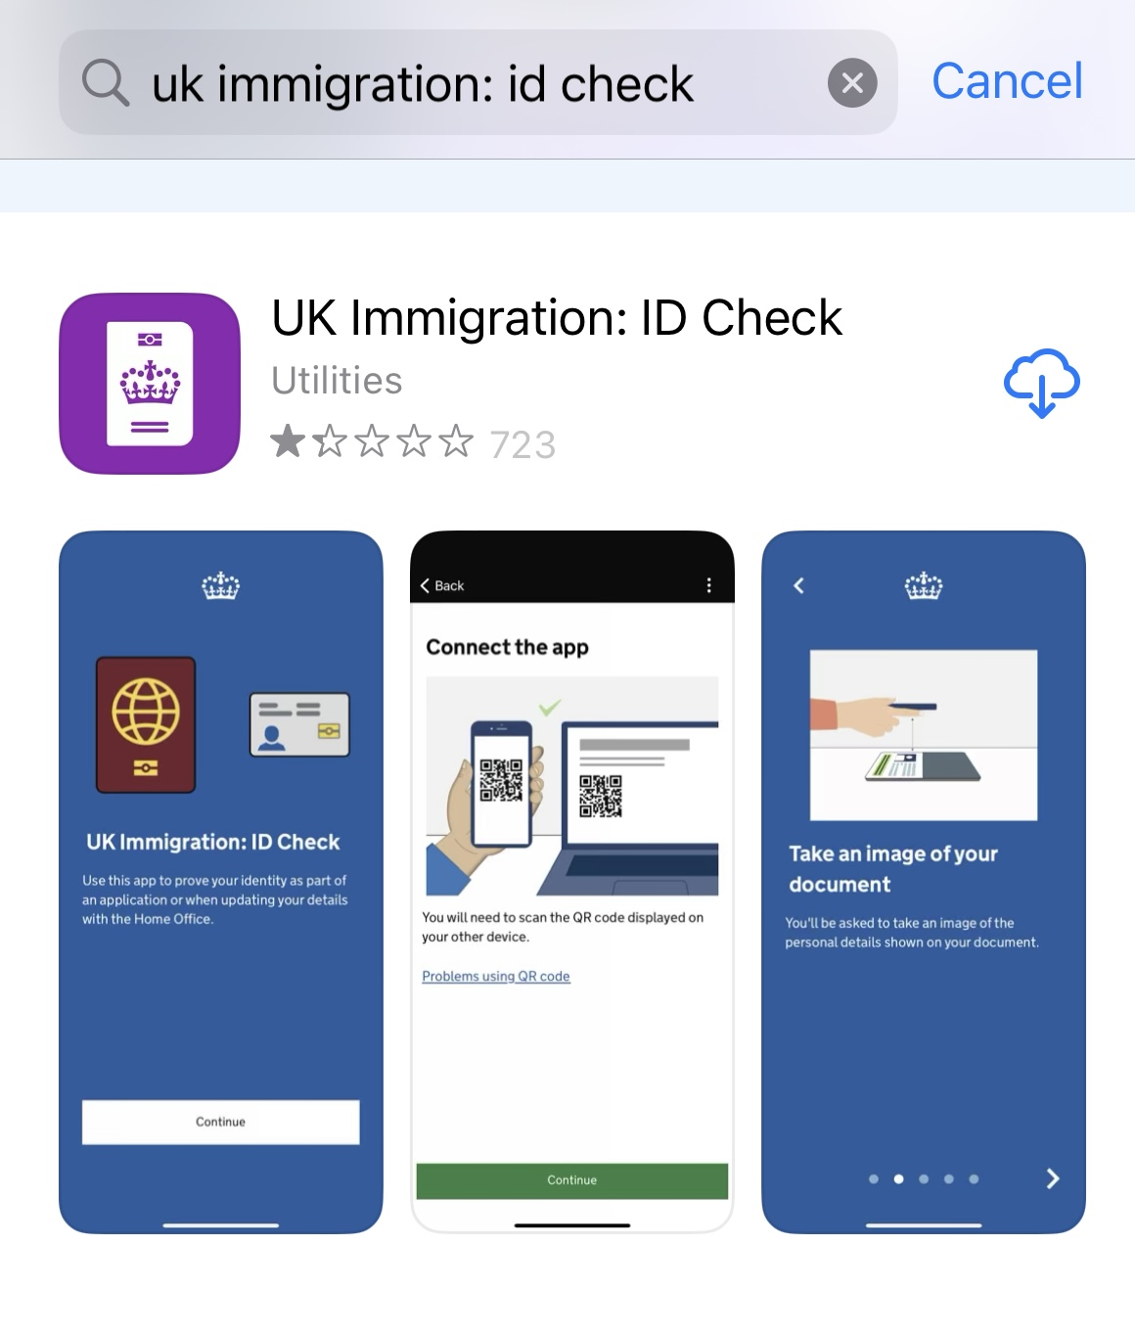

Slide 23
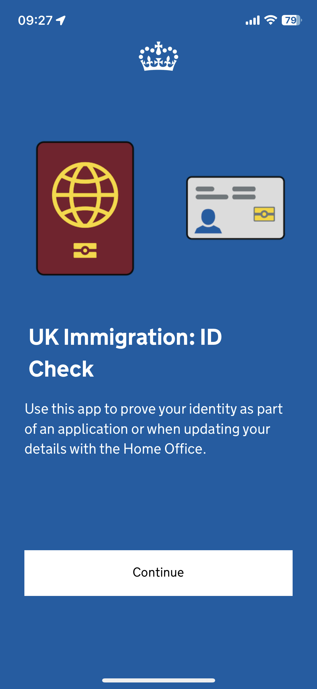

Slide 25
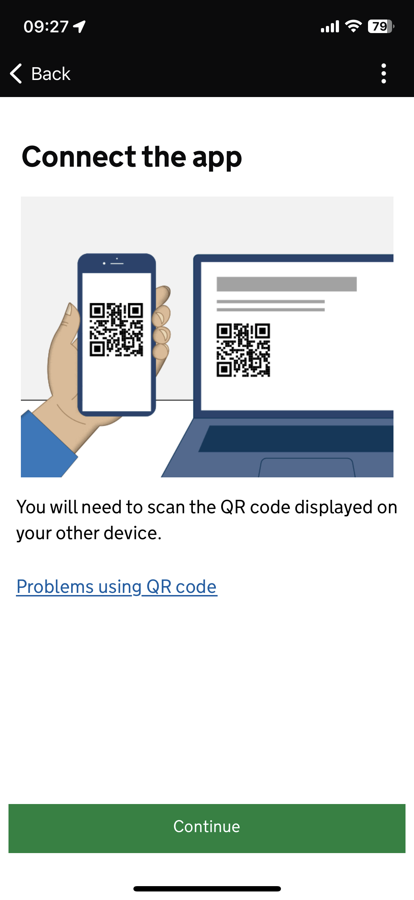

Slide 26
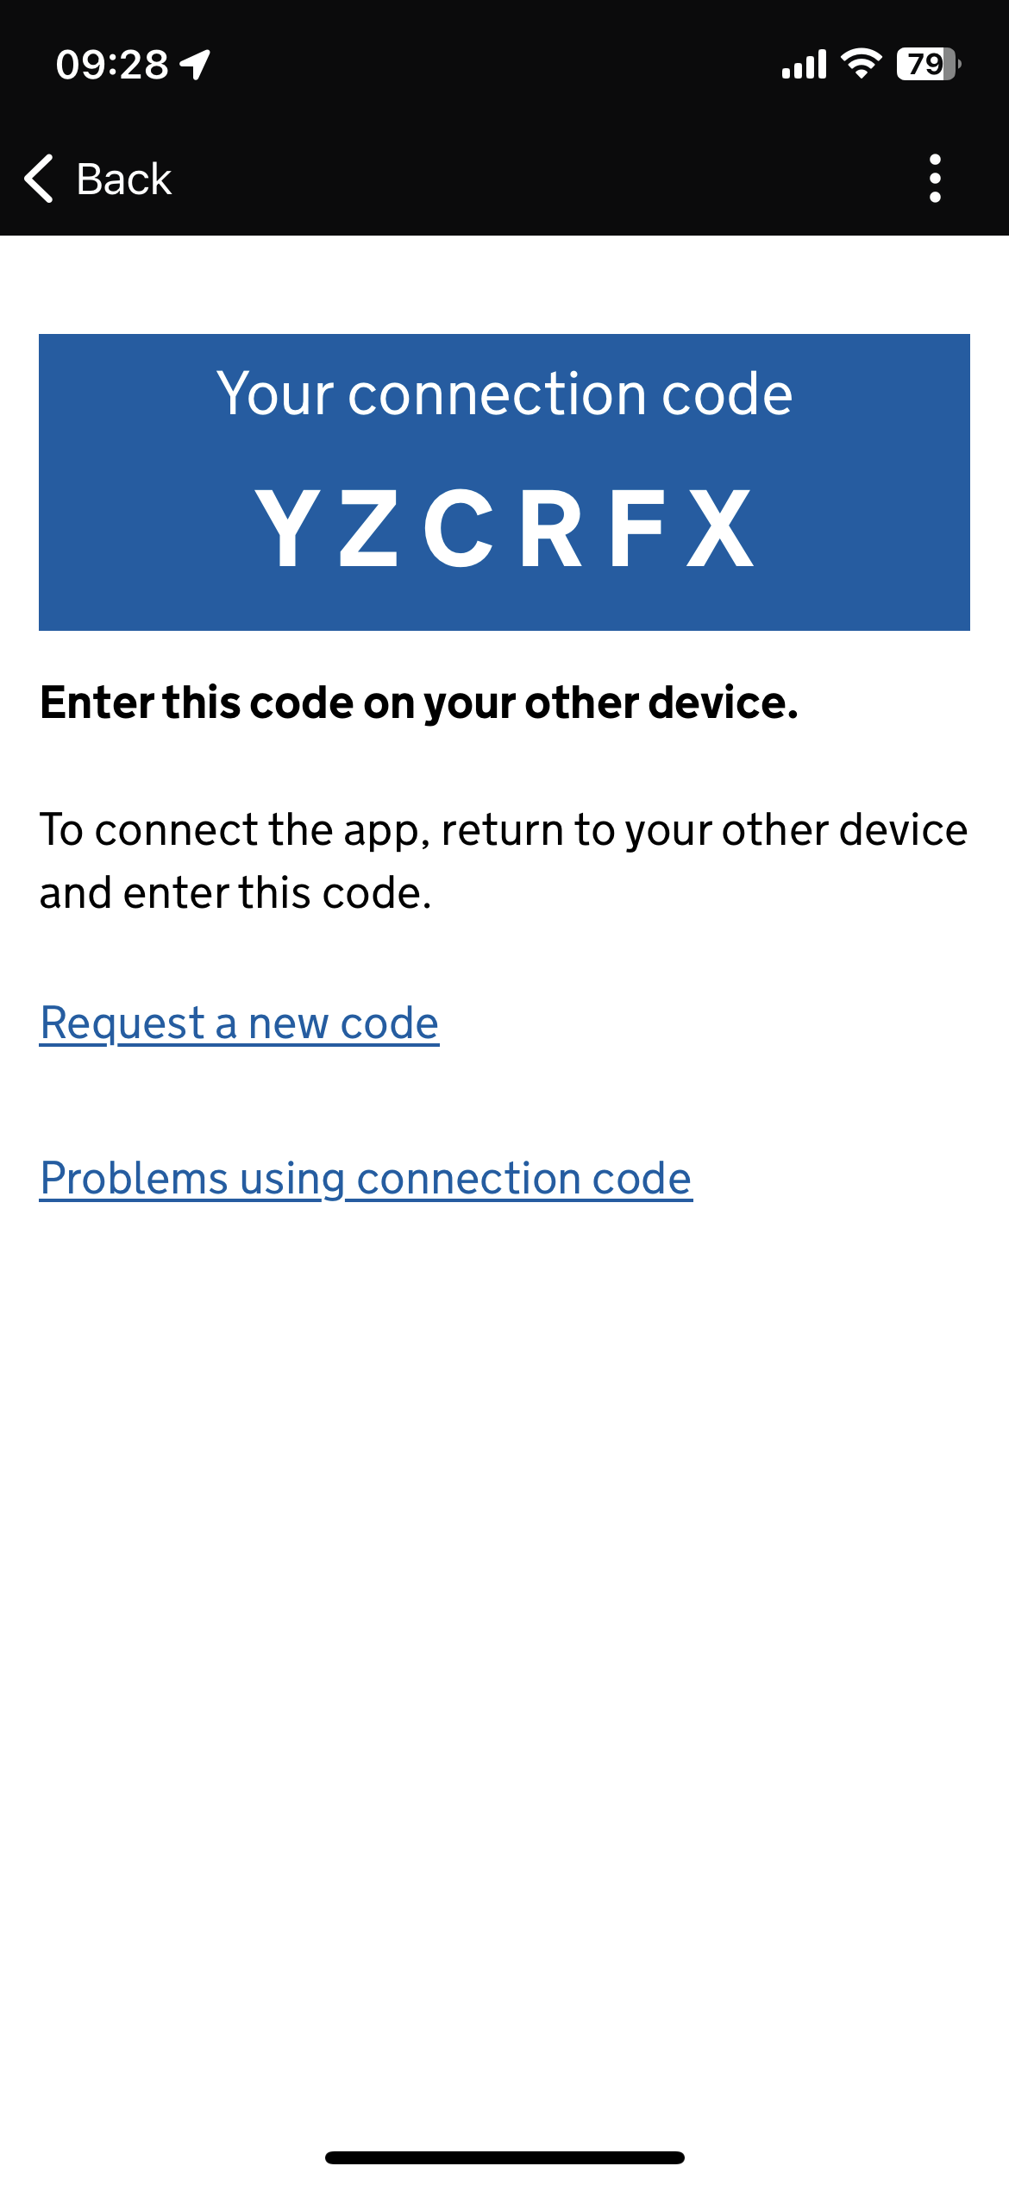

Slide 27
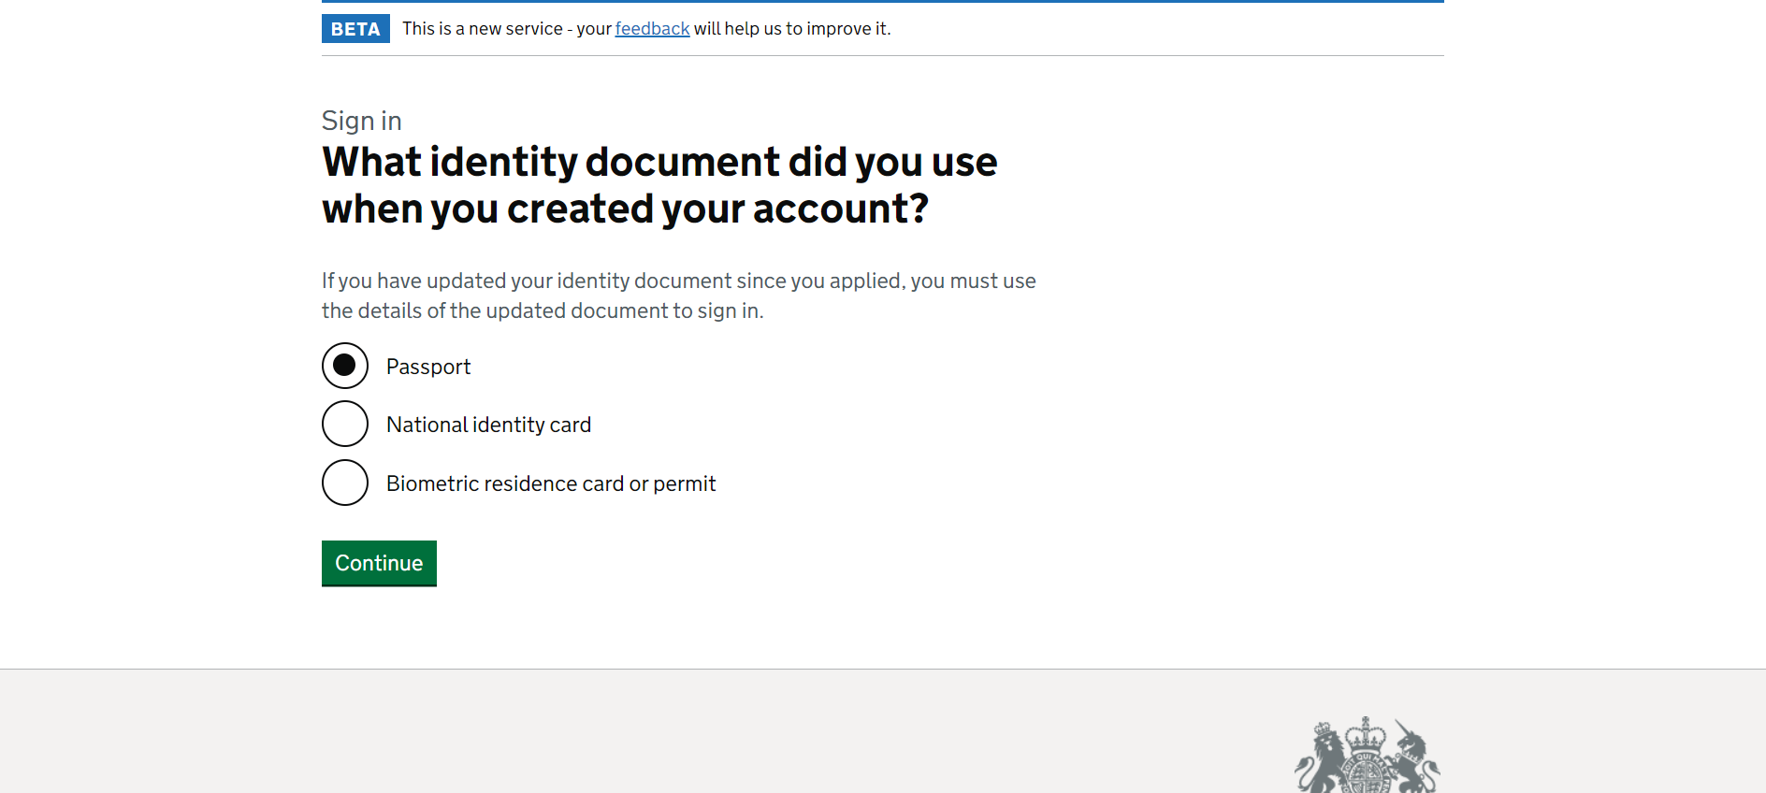

Slide 28
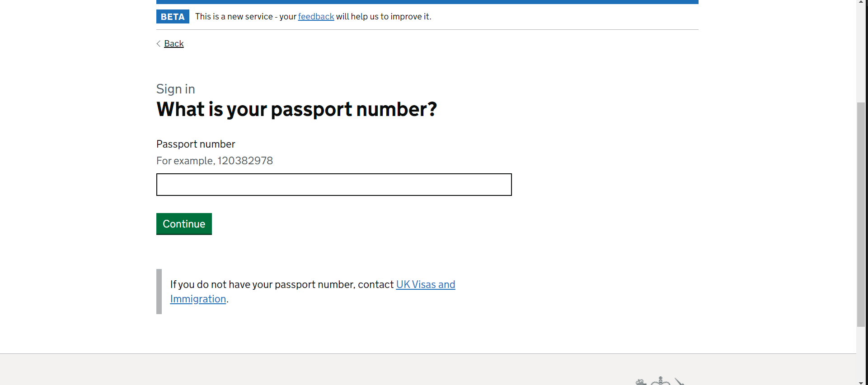

Slide 29
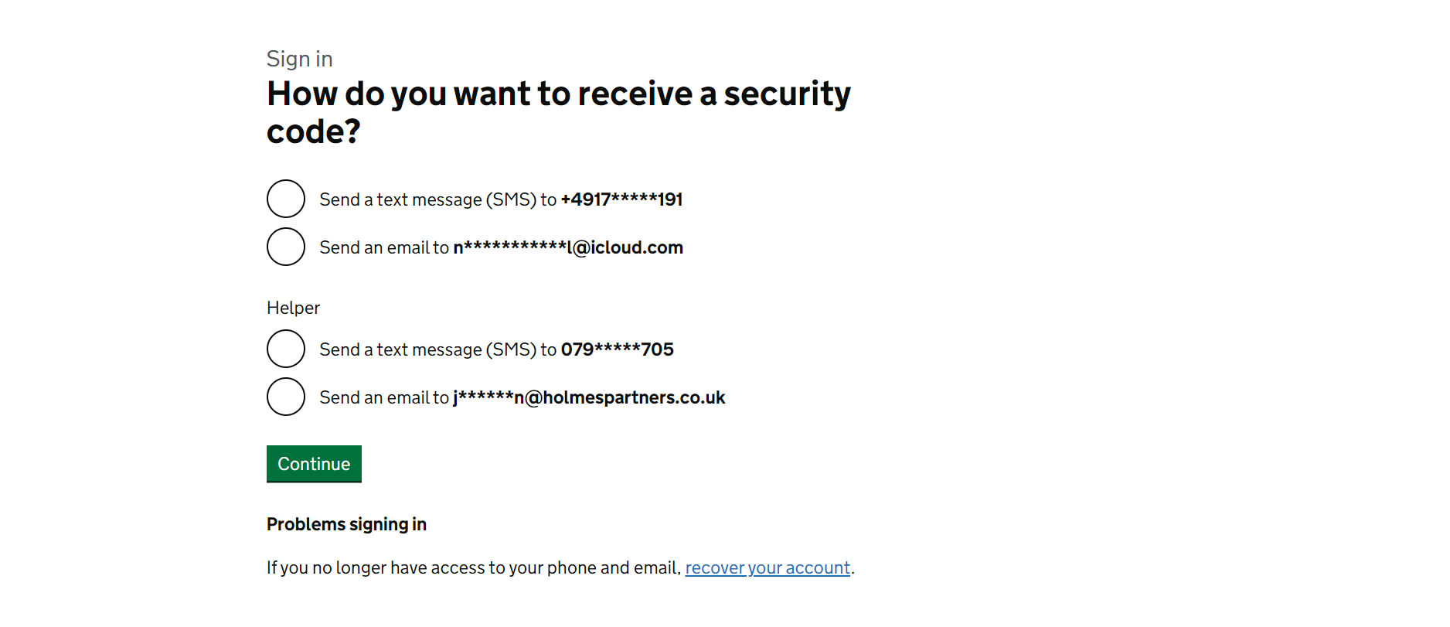

Slide 30
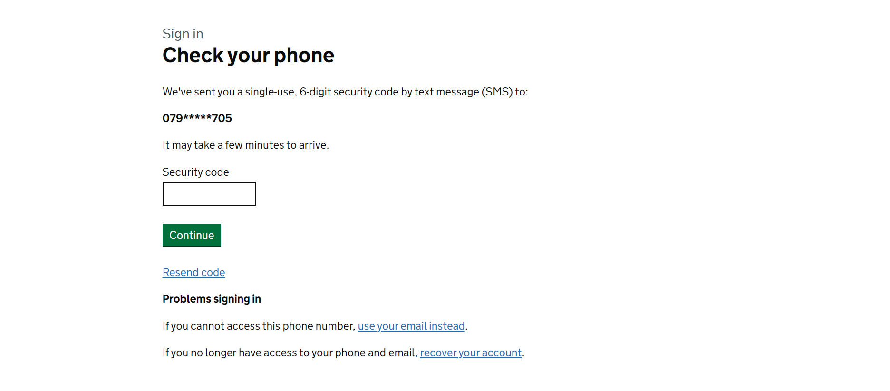

Slide 31
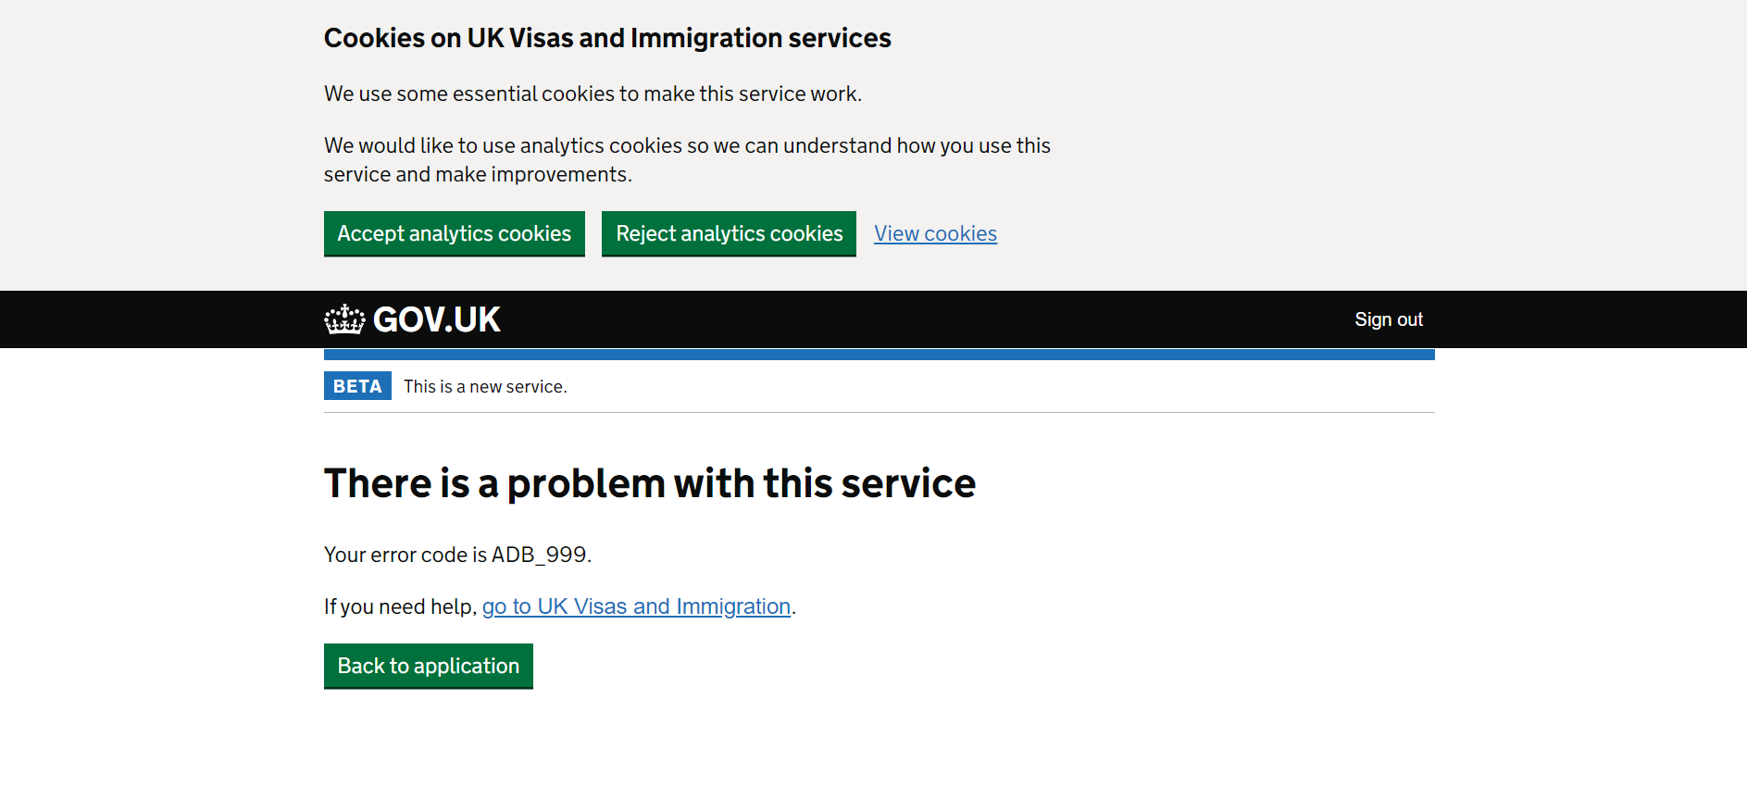

Slide 32
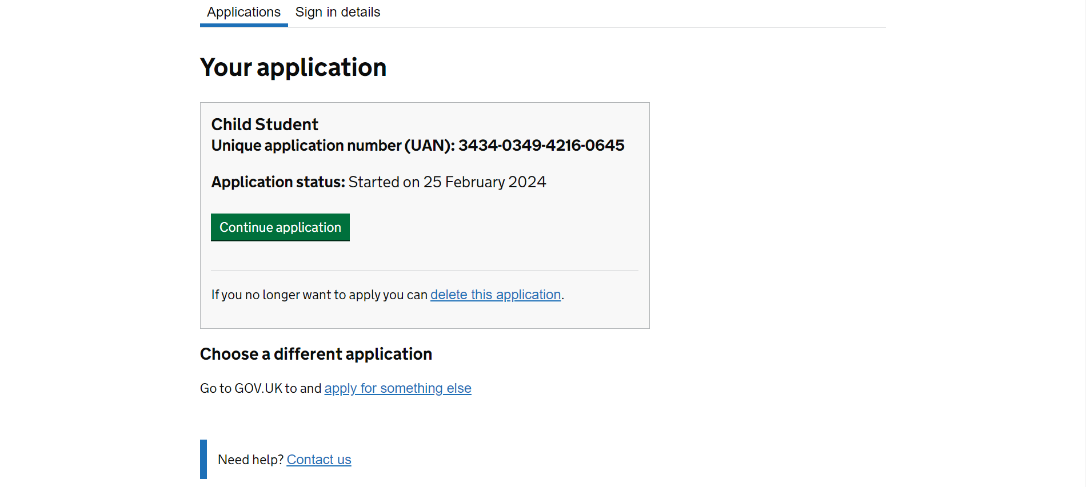

Slide 34
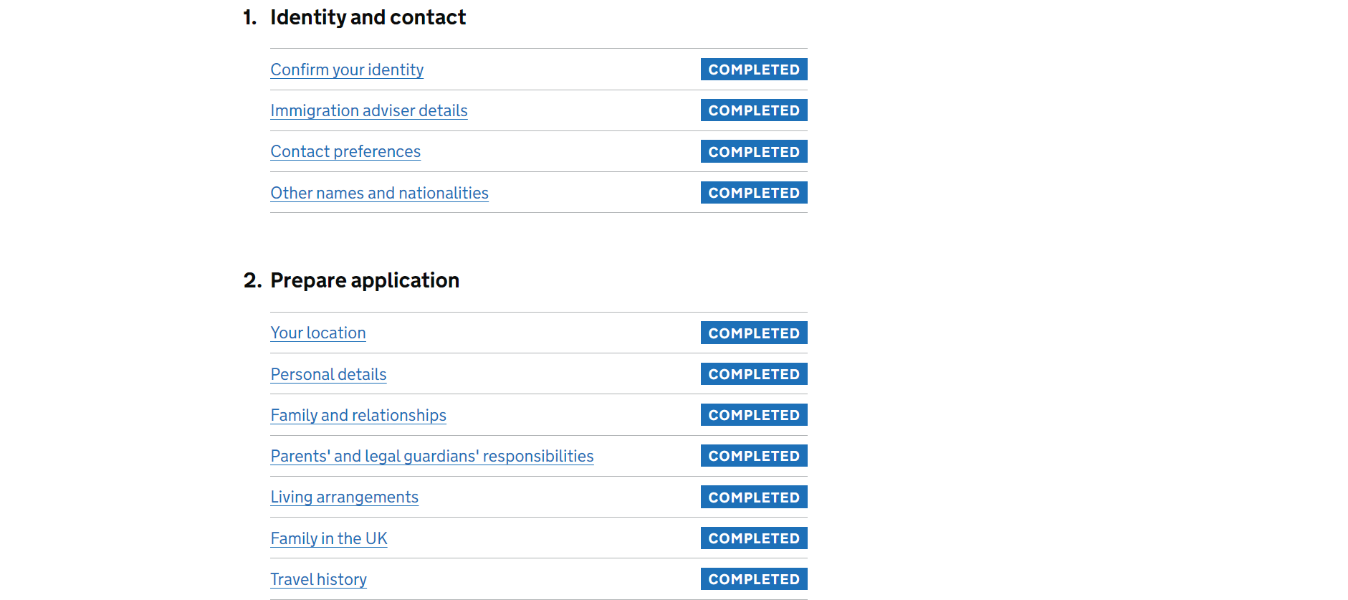

Slide 35
Guardianship & Travel details
If you do not have a guardian in place, you can select ‘no’ and
move the application on
Travel:
Provide the last 3 times travelled within the EU
Provide the last 5 times travelled to other countries outside
of the EU

Slide 36
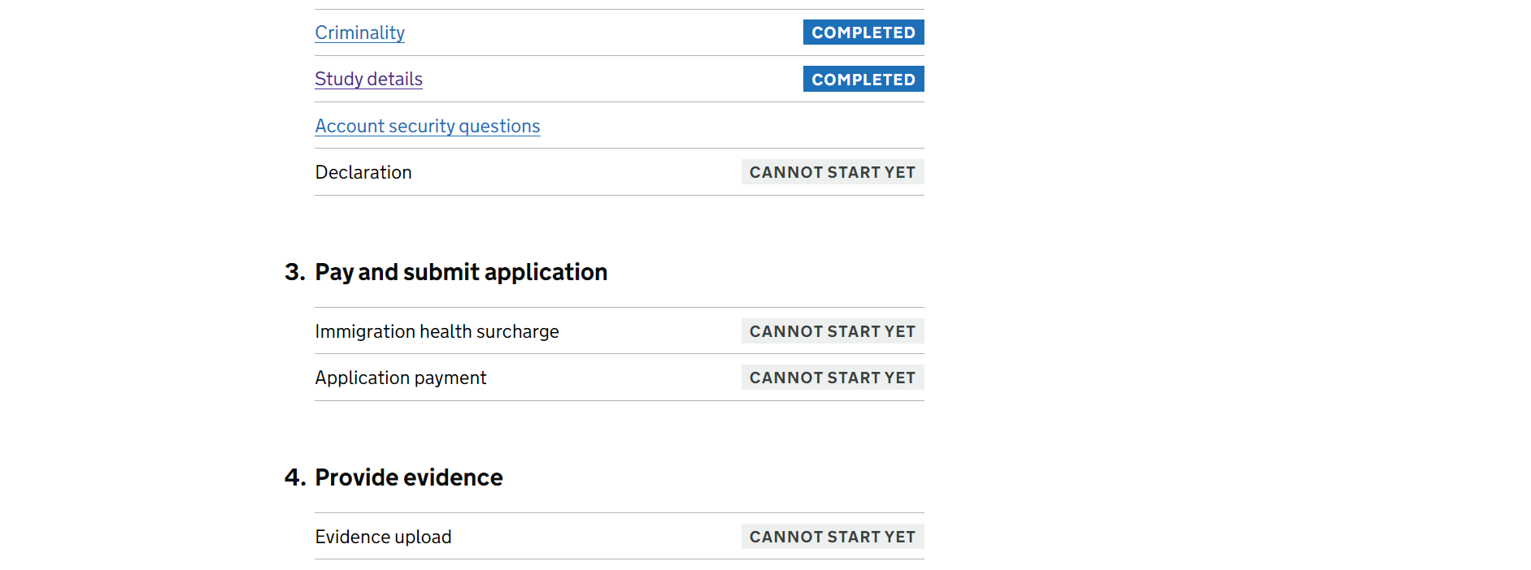

Slide 37
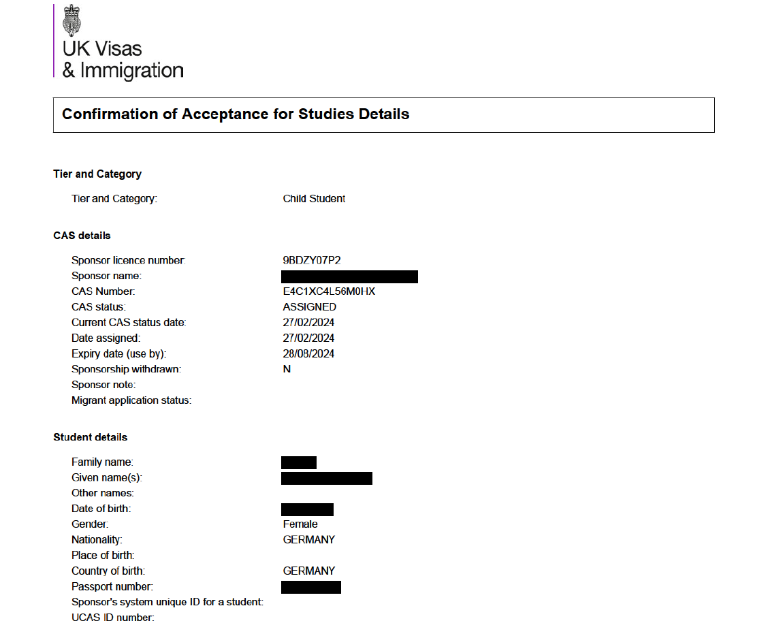

Slide 38
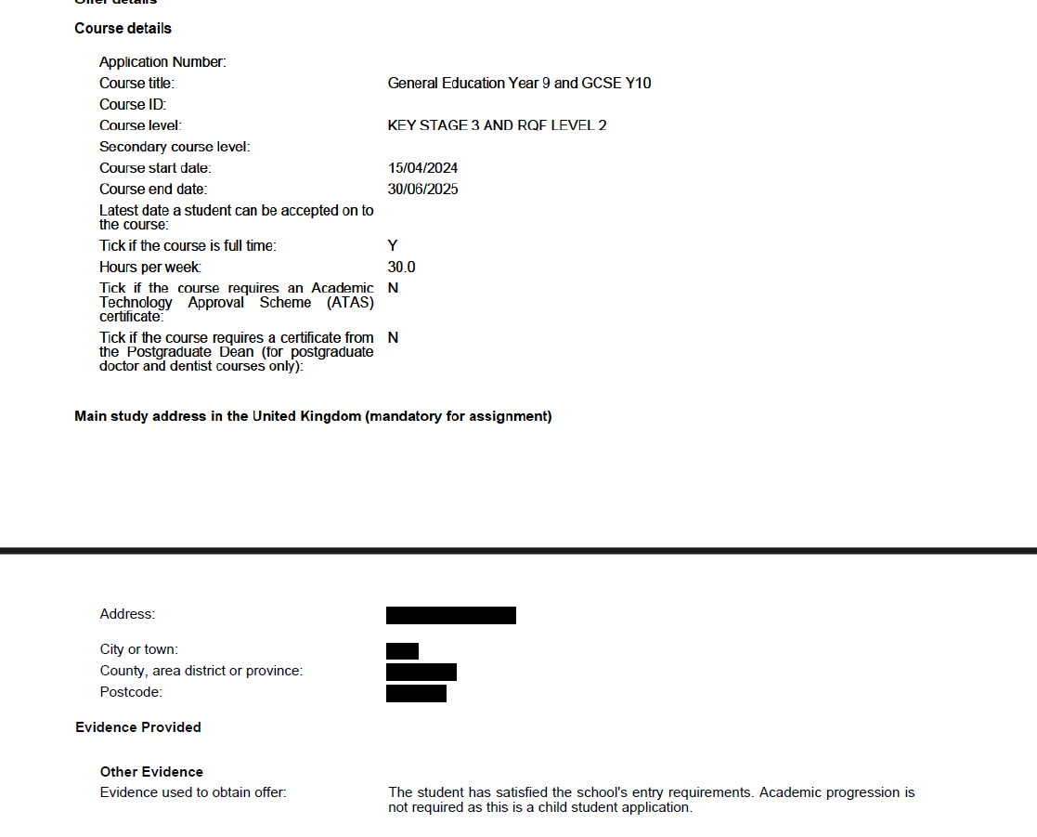

Slide 39
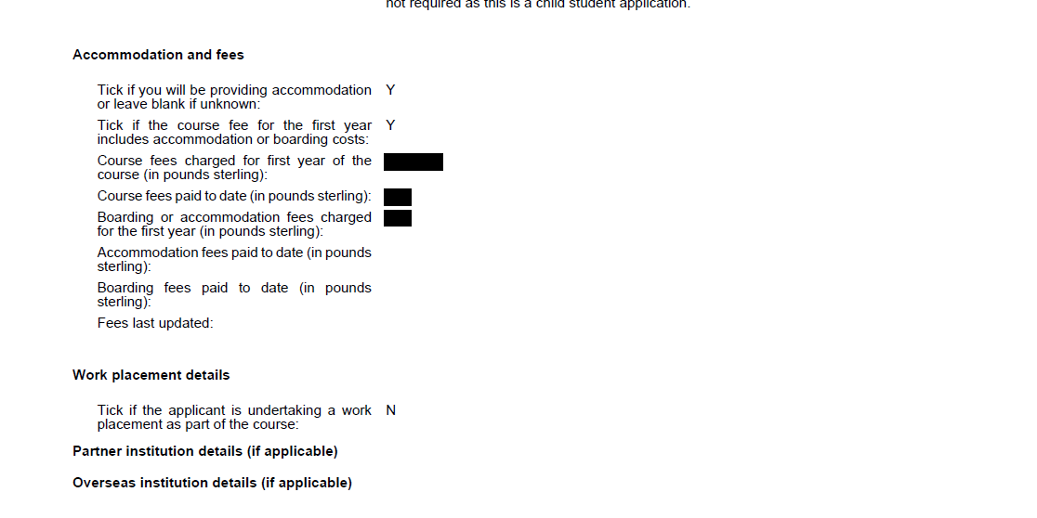

Slide 41
What is the costs?

Slide 42
Immigration Health Surcharge Fee
Up to the first eight (8) months
£776.00
Over 8 months it is £1164.00 per year
1 year course = £1164.00
2 year course = £1,940.00
3 year course = £2,716.00
Visa fee
£490.00

Slide 44
Evidence to upload
Birth certificate with a certified English translation
Signed parental consent letter – the school shall provide you
with the letter

Slide 45
Possible issues you may come across

Slide 46
UK Immigration ID Check App
Multiple attempts to scan biometric chip
Logs out after a certain amount – wait 24 hours
Make sure the phone touch the cover of the passport

Slide 47
Payments – IHS
Do not accept all credit cards
After the 5th attempt – blocks application
Have to start again

Slide 48
What is next

Slide 49
Decision time can take up to 3 weeks or longer between June to September
Decision Email

Slide 50
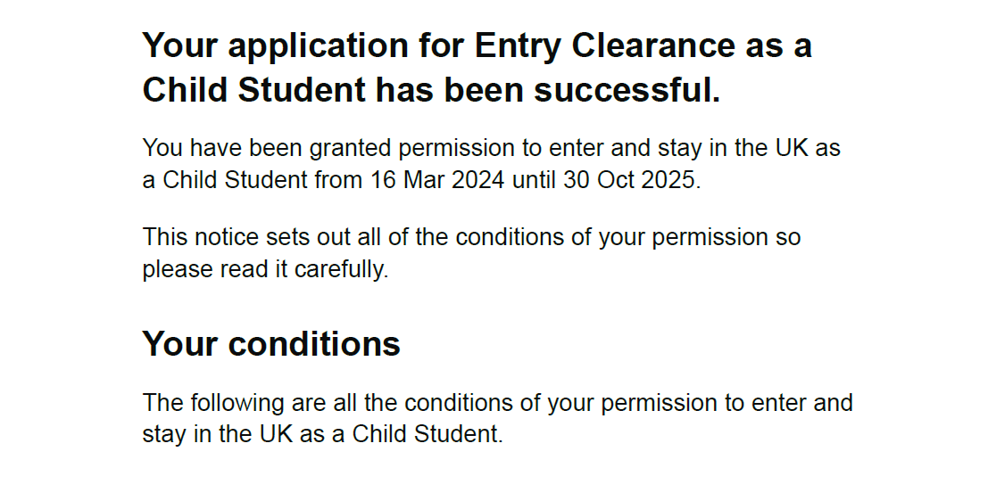

Slide 51
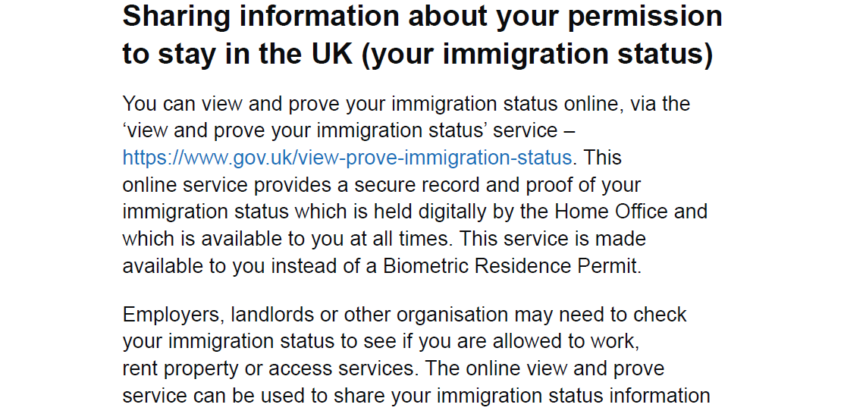

Slide 52
Not sending out decision email – another way to check is to try to log into: https://www.gov.uk/view-prove-immigration-status
You will need your child’s passport and/or date of birth
If you are able to log into the above link, it means the visa was approved and you will be able to generate a share code

Slide 53
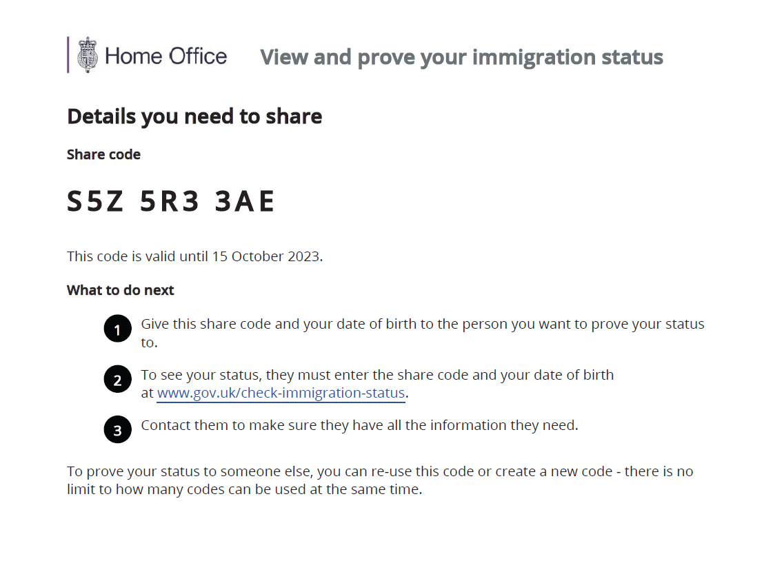

Slide 54
Do not book flights
Do not enter as a visitor if you intend to study
Plenty of time to apply for a visa
Duration of stay - extend

Slide 55
How we can help
We provide a full end-to-end visa application service. We shall send you a step-by-step guide on how to complete the ID verification step and guide you through the process, if need be.
We shall complete the rest of the form and advise on the payment section and upload the necessary evidence.
We will answer all your questions throughout the process – there is no limit
As the named immigration advisers on file, we can communicate with the UKVI on your behalf
We have a direct email to assist with Immigration Health Surcharge refunds
Our fee is £400

Slide 56
Contact Details

Slide 57
Email: michelle@holmespartners.co.uk
Telephone: +44113 524 6995
Mobile: +447726671774
Website: www.holmes-partners.co.uk
https://www.linkedin.com/in/michelle-holmes-22969053/

Slide 58
Other points to consider
Financial evidence
New passport
ID checks can be completed in the UK for renewal/Extension visas
Always check the spam folder

